Slide 1


Cryptocurrency and Blockchain
Presents: Evyatar Hai & Lior Reinitz.
Moderator: Professor Dani Kotler.

Slide 2
Theoretical Background
Introduction to Cryptography & Cryptocurrencies
Cryptographic Hash Functions
Hash Pointers and Data Structures
Digital Signatures
Mechanics of Bitcoin
Bitcoin transactions
Bitcoin blocks
How Bitcoin Achieves Decentralization
Incentives and proof of work

Slide 3
Introduction to Cryptography & Cryptocurrencies

Slide 4
Cryptographic Hash Functions (1)
A hash function is a mathematical function with the following three properties:
1. Its input can be any string of any size.
2. It produces a fixed size output(256‐bit).
3. It is efficiently computable. More technically, computing the hash of an n‐bit string should have a running time that is O(n).
For a hash function to be cryptographically secure, we’re going to require that it has the following three additional properties:
(1) collision‐resistance, (2) hiding, (3) puzzle‐friendliness.
Notes:
According to time limit we will expand only the first property – collision – resistance.

Slide 5
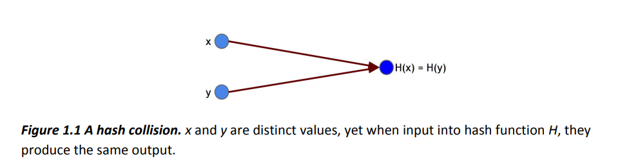
Cryptographic Hash Functions (2)
Property 1: Collision‐resistance
Collision‐resistance: A hash function H is said to be collision resistant if it is infeasible to find two values, x and y, such that x ≠ y, yet H(x)=H(y).
Notes:
Notice that we said nobody can find a collision, but we did not say that no collisions exist.
Actually, we know for a fact that collisions do exist, and we can prove this by a simple counting argument
(Because the input space is larger than the output space there must be input strings that map to the same output string - Pigeonhole Principle ).

Slide 6
Hash Pointers and Data Structures (1)
A hash pointer is a pointer to where data is stored together with a cryptographic hash of the value of that data at some fixed point in time.
Whereas a regular pointer gives you a way to retrieve the information, a hash pointer also gives you a way to verify that the information hasn’t changed.
We can use hash pointers to build all kinds of data structures. Intuitively, we can take a familiar data structure that uses pointers such as a linked list or a binary search tree and implement it with hash pointers, instead of pointers as we normally would.

Slide 7
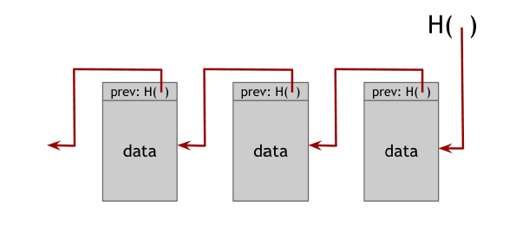
Hash Pointers and Data Structures (2)
A Blockchain is a linked list that is built with hash pointers instead of pointers.
Notes:
Whereas as in a regular linked list where you have a series of blocks, each block has data as well as a pointer to the previous block in the list, in a block chain the previous block pointer will be replaced with a hash pointer.
So each block not only tells us where the value of the previous block was, but it also contains a digest of that value that allows us to verify that the value hasn’t changed.
We store the head of the list, which is just a regular hash‐pointer that points to the most recent data block.

Slide 8
Hash Pointers and Data Structures (3)
A use case for a blockchain is a tamper‐evident log . That is, we want to build a log data structure that
stores a bunch of data, and allows us to append data onto the end of the log.
But if somebody alters data that is earlier in the log, we’re going to detect it.
the adversary’s goal is to do it in such a way that someone who remembers only the hash pointer at the head
of the block chain won’t be able to detect the tampering.
To achieve this goal the adversary changes the data of some block k. Since the data has been changed, the hash in block k + 1,
which is a hash of the entire block k , is not going to match up.
as long as we store the hash pointer at the head of the list in a place where the adversary cannot change it,
the adversary will be unable to change any block without being detected.
by just remembering a single hash pointer, we’ve essentially remembered a tamper‐evident hash of the entire list.
So we can build a block chain like this containing as many blocks as we want, going back to some special block at the
beginning of the list, which we will call the genesis block .
Notes:
To understand why a block chain achieves this tamper‐evident property, let’s ask what happens if an adversary wants to tamper with data that’s in the middle of the chain. Specifically, the adversary’s goal is to do it in such a way that someone who remembers only the hash pointer at the head of the block chain won’t be able to detect the tampering. To achieve this goal, the adversary changes the data of some block k . Since the data has been changed, the hash in block k + 1, which is a hash of the
entire block k , is not going to match up.
Remember that we are statistically guaranteed that the new hash will not match the altered content since the hash function is collision resistant. And so we will
detect the inconsistency between the new data in block k and the hash pointer in block k + 1. Of course the adversary can continue to try and cover up this change by changing the next block’s hash as well. The adversary can continue doing this, but this strategy will fail when he reaches the head of the list. Specifically, as long as we store the hash pointer at the head of the list in a place where the adversary cannot change it, the adversary will be unable to change any block without being detected.
The upshot of this is that if the adversary wants to tamper with data anywhere in this entire chain, in order to keep the story consistent, he’s going to have to tamper with the hash pointers all the way back to the beginning. And he’s ultimately going to run into a roadblock because he won’t be able to tamper with the head of the list.
Thus it emerges, that by just remembering this single hash pointer, we’ve essentially remembered a tamper‐evident hash of the entire list. So we can build a block chain like this containing as many blocks as we want, going back to some special block at the beginning of the list, which we will call the genesis block .
You may have noticed that the block chain construction is similar to the Merkle‐Damgard construction that we saw in the previous section. Indeed, they are quite similar, and the same security argument applies to both of them.

Slide 9
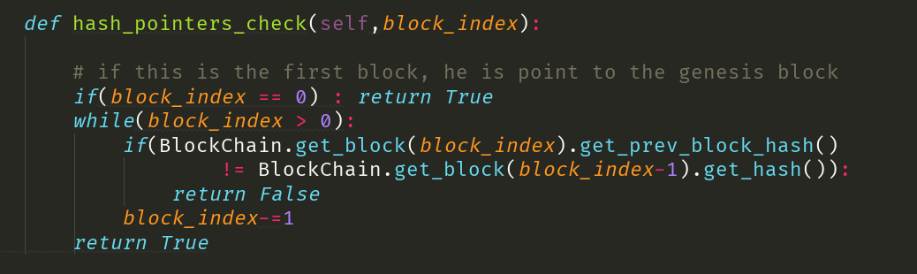
Hash pointers in the simulator
Checking hash pointers of the blocks backward, if some of the hash pointers of the block changed, we declined the transaction.
We checking if the current hash of the block is equal to the previous hash pointer.

Slide 10
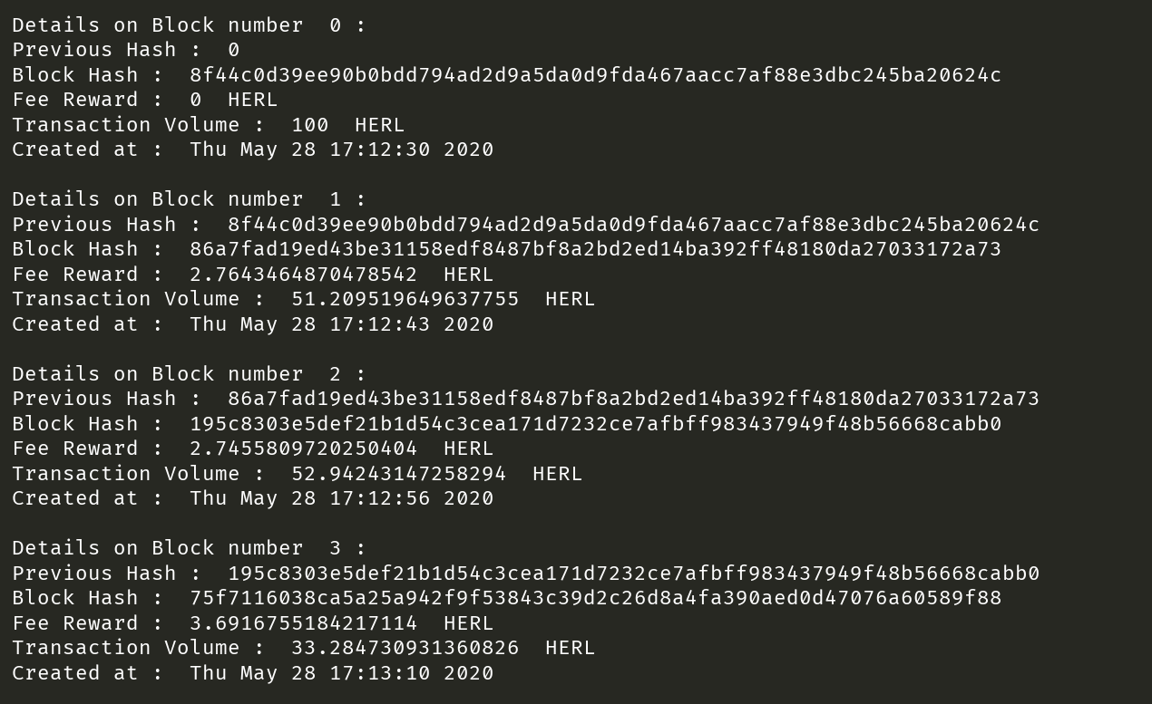
Hash pointers in the simulator(2)
We can see that the hash pointer, point to the previous block.
The first one is the genesis block, so its doesn’t point of anything.

Slide 11
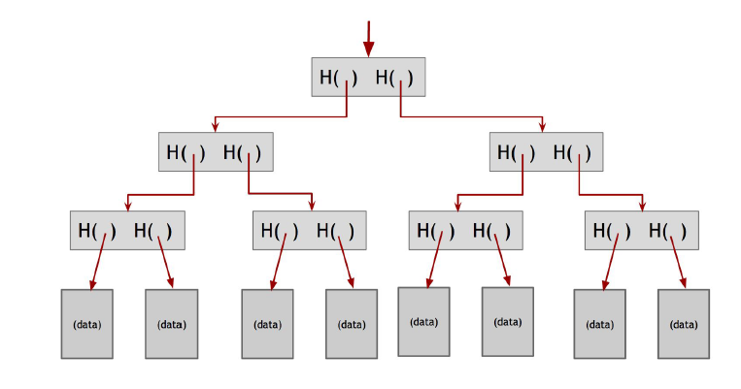
Hash Pointers and Data Structures (4)
A binary tree with hash pointers is known as a Merkle tree , after its inventor Ralph Merkle.
Notes:
Another useful data structure that we can build using hash pointers is a binary tree.
Suppose we have a number of blocks containing data. These blocks comprise the leaves of our tree. We group these data blocks into pairs of two, and then for each pair, we build a data structure that has two hash pointers, one to each of these blocks. These data structures make the next level up of the tree. We in turn group these into groups of two, and for each pair, create a new data structure that contains the hash of each. We continue doing this until we reach a single block, the root of the tree.
As before, we remember just the hash pointer at the head of the tree. We now have the ability traverse down through the hash pointers to any point in the list.
This allows us make sure that the data hasn’t been tampered with because, just like we saw with the block chain, if an adversary tampers with some data block at the bottom of the tree, that will cause the hash pointer that’s one level up to not match, and even if he continues to tamper with this block, the change will eventually
propagate to the top of the tree where he won’t be able to tamper with the hash pointer that we’ve stored.
So again, any attempt to tamper with any piece of data will be detected by just remembering the hash pointer at the top.

Slide 12
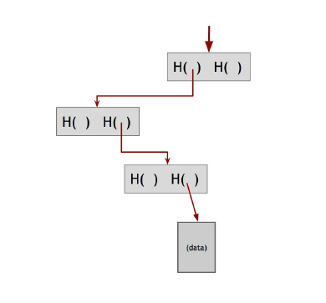
Hash Pointers and Data Structures (5)
Proof of membership. To prove that a data block is included in the tree, one only needs to
show the blocks in the path from that data block to the root.
If there are n nodes in the tree, only about log(n) items need to be shown.
And since each step just requires computing the hash of the child block, it takes about log(n) time for us to verify it.
Notes:
Proof of membership.
Another nice feature of Merkle trees is that, unlike the block chain that we built before, it allows a concise proof of membership.
Say that someone wants to prove that a certain data block is a member of the Merkle Tree.
As usual, we remember just the root. Then they need to show us this data block, and the blocks on the path from the data block to the root.
We can ignore the rest of the tree, as the blocks on this path are enough to allow us to verify the hashes all the way up to the root of the tree.
If there are n nodes in the tree, only about log(n) items need to be shown. And since each step just requires computing the hash of the child block, it takes about log(n) time for us to verify it. And so
even if the Merkle tree contains a very large number of blocks, we can still prove membership in a relatively short time. Verification thus runs in time and space that’s logarithmic in the number of nodes in the tree.

Slide 13
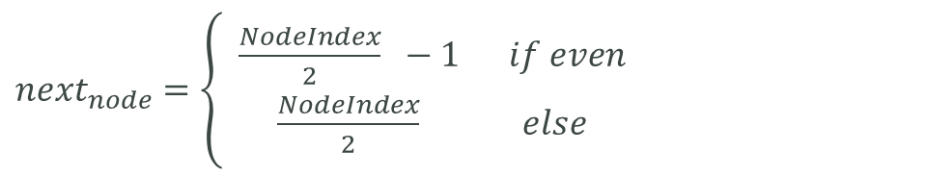
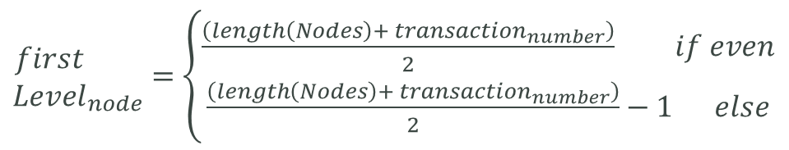
Merkle tree example for 16 transaction
${\begin{aligned}first \\ Level\end{aligned}}_{node}=$ $\left\{\begin{aligned}\frac{\left(length\left(Nodes\right)+ transaction_{number}\right)}{2} if even \\ \frac{\left(length\left(Nodes\right)+ transaction_{number}\right)}{2}−1 else\end{aligned}\right.$
N0 = Root = 0
${next}_{node}=$ $\left\{ \begin{aligned}\frac{NodeIndex}{2} −1 if even \\ \frac{NodeIndex}{2} else\end{aligned}\right.$
N1
N2
N = Node
T = Transaction
N3
N4
N5
N6
N7
N8
N9
N10
N11
N12
N13
N14
First
level
T0
T1
T2
T3
T4
T5
T6
T7
T8
T9
T10
T11
T12
T13
T14
T15
Lets have a look for example, we want to check if the transaction T6 is valid.
The neighbor of T6 is T7.
Because its ordered in list, we need to get the N10, so how we can get the N10?
By the formula above.

Slide 14
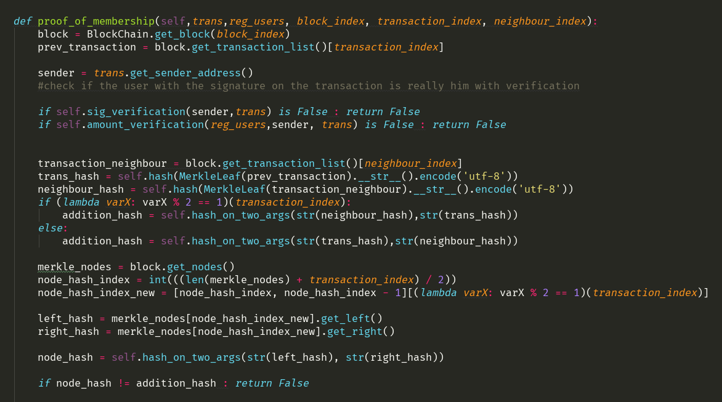
Proof of membership – code(1)
The function get the transaction, the block index, the transaction index and the neighbor index.
We apply the hash function on the previous transaction and on the neighbor transaction to get the hash of there father.
This is the formula to get the actual node from the Merkle tree to check if the addition hash from above, is equal to the hash of the node. if it is, so we climbing up in the tree.

Slide 15
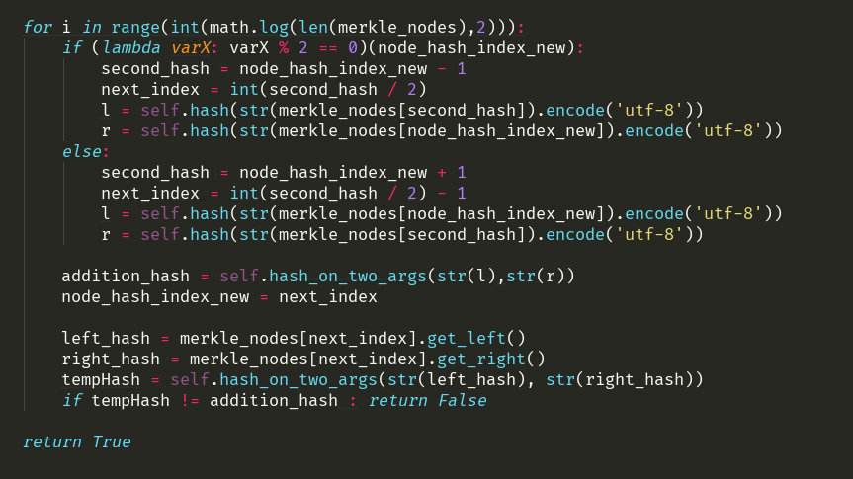
Proof of membership – code(2)
The run time of the validation of the nodes is log(n) like we saw 2 slides before.
Each iteration, we take the 2 leaf's of the node that we got from the formula and apply the hash function on them.
If the addition hash of them is equal to the addition hash of the actual node, we keep climbing up until we get to the root and then we can ensure that the transaction is valid.

Slide 16
Digital Signatures
A digital signature is supposed to be the digital analog to a handwritten signature on paper.
We desire two properties from digital signatures that correspond well to the handwritten signature analogy:
1. Only you can make your signature, but anyone who sees it can verify that it’s valid.
2. We want the signature to be tied to a particular document so that the signature cannot be used to indicate your agreement of a different document.

Slide 17
Digital Signatures (2)
A digital signature scheme consists of the following three algorithms:
(sk, pk) := generateKeys( keysize ).
sig := sign( sk , message ).
isValid := verify( pk , message , sig )
We require that the following two properties hold:
● Valid signatures must verify
verify ( pk , message , sign ( sk , message )) == true
● Signatures are existentially unforgeable
Notes:
1. The secret key sk is kept privately and used to sign messages.
pk is the public verification key that you give to everybody.
Anyone with this key can verify your signature.
2. The sign method takes a message and a secret key, sk , as input and outputs a signature for message under sk.
3.The verify method takes a message, a signature, and a public key as input. It returns a boolean value, isValid , that will be true if sig is a valid signature for message under public key pk , and false otherwise.

Slide 18
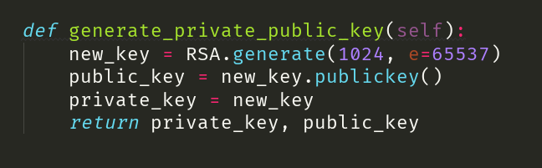
Digital signature - code(1)
(sk, pk) := generateKeys( keysize ).
We use RSA module to generate private key and public key.
The key is in length of 1024 bits.
The exponent is 65,537.

Slide 19
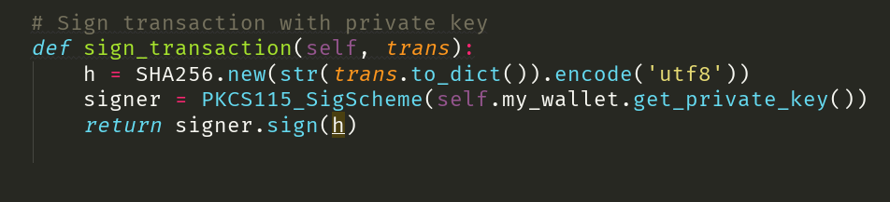
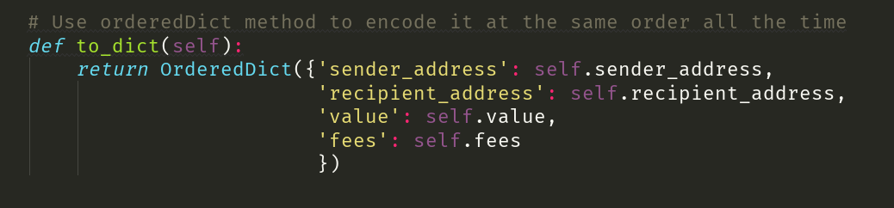
Digital signature - code(2)
sig := sign( sk , message ).
The message is the string ordered by the function to_dict() after we transfer it in the SHA256 module.
We sign the message with the sender private key by using the signature scheme, known as PKCS115_SigScheme.
In cryptography, PKCS stands for "Public Key Cryptography Standards". These are a group of public-key cryptography standards devised and published by RSA Security LLC. (took from here: https://en.wikipedia.org/wiki/PKCS).

Slide 20
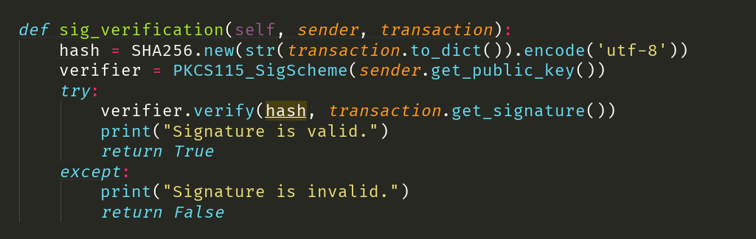
Digital signature - code(3)
isValid := verify( pk , message , sig )
In this function we verify if the signature is valid or not.
We checking it to ensure that the user who sign on the transaction is really him.
First, we transfer the to_dict() message in the SHA256 module to get the message hashed.
We sent to the signature scheme the public key of the sender (the user who sign the transaction with his private key).
Then, we verify the signature of the transaction with the message, by using the function verify.

Slide 21
Mechanics of Bitcoin

Slide 22
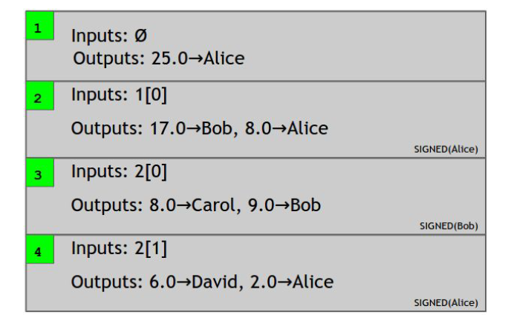
Bitcoin transactions (1)
A transaction - Bitcoin’s fundamental building block.
Bitcoin uses a transaction-based ledger that just keeps track of transactions.
Notes:
The downside to this way of doing things is that anyone who wants to determine if a transaction is valid will have to keep track of these account balances.
Take another look at the attached figure - Does Alice have the 15 coins that she’s trying to transfer to David?
To figure this out, you’d have to look backwards in time forever to see every transaction affecting Alice, and whether or not her net balance at the time that she tries to transfer 15 coins to David is greater than 15 coins.
Of course we can make this a little bit more efficient with some data structures that track Alice’s balance after each transaction. But that’s going to require a lot of extra housekeeping besides the ledger itself.
Transactions specify a number of inputs and a number of outputs .
You can think of the inputs as coins being consumed (created in a previous transaction) and the outputs as coins being created.
For transactions in which new currency is being minted, there are no coins being consumed .
Each transaction has a unique identifier.
Outputs are indexed beginning with 0, so we will refer to the first output as “output 0”.
Let’s now work our way through the figure - Transaction 1 has no inputs because this transaction is creating new coins, and it has an output of 25 coins going to Alice.
Also, since this is a transaction where new coins are being created, no signature is required.
Now let’s say that Alice wants to send some of those coins over to Bob. To do so, she creates a new transaction, transaction 2 in our
example. In the transaction, she has to explicitly refer to the previous transaction where these coins
are coming from. Here, she refers to output 0 of transaction 1 (indeed the only output of transaction
1), which assigned 25 bitcoins to Alice. She also must specify the output addresses in the transaction.
In this example, Alice specifies two outputs, 17 coins to Bob, and 8 coins to Alice. And, of course, this
whole thing is signed by Alice, so that we know that Alice actually authorizes this transaction.
. Why does Alice have to send money to herself in this example ? In Bitcoin, the entirety of a transaction output must be consumed by
another transaction, or none of it. Alice only wants to pay 17 bitcoins to Bob, but the output that she
owns is worth 25 bitcoins. So she needs to create a new output where 8 bitcoins are sent back to
herself.

Slide 23
Bitcoin blocks (1)
The block chain is a clever combination of two different hash-based data structures:
1. Hash chain of blocks that links the different blocks to one another. Each block has a block header, a hash pointer to some transaction data, and a hash pointer to the previous block in the sequence.
2. Internal to each block. A Merkle Tree of all of the transactions that are included in that block. The Merkle Tree allows us to have a digest of all the transactions in the block in an efficient way.
Notes:
So far in this chapter we’ve looked at how individual transactions are constructed and redeemed.
Transactions are grouped together into blocks. Why is this? Basically, it’s an optimization.
If miners had to come to consensus on each transaction individually, the rate at which new transactions could be accepted by the system would be much lower.
Also, a hash chain of blocks is much shorter than a hash chain of transactions would be, since a large number of transactions can be put into each block.
This will make it much more efficient to verify the block chain data structure.

Slide 24
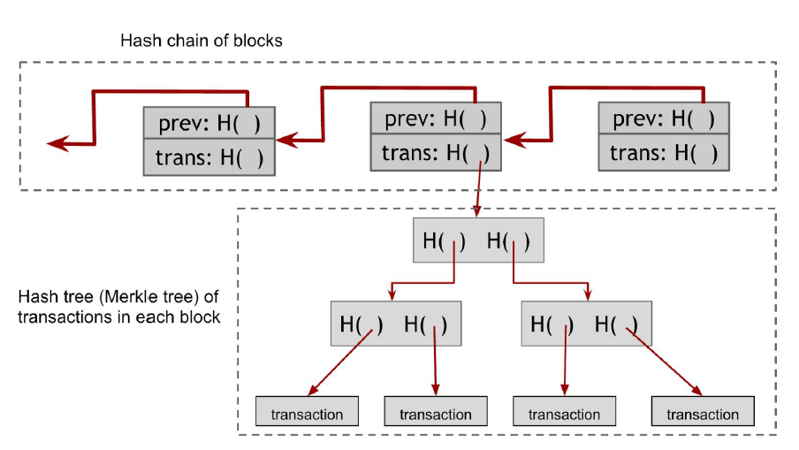
Bitcoin blocks (2)

Slide 25
How Bitcoin Achieves Decentralization

Slide 26
Incentives and proof of work (1)
we would like to reward each of the nodes that created the blocks that did end up on the long‐term consensus chain.
There are two separate incentive mechanisms in Bitcoin:
Block reward
Transaction fees

Slide 27
Incentives and proof of work (2)
Block reward- The node that creates a block gets to include a special transaction in that block. We can think of this as a payment to the node in exchange for the service of creating a block on the consensus chain.
Why the block reward incentivizes honest behavior?
It may appear, that this node gets the block reward regardless of whether it proposes a valid block or behaves maliciously. But this is not true!
How will this node “collect” its reward? That will only happen if the block ends up on the long‐term consensus branch because just like every other transaction, the coin‐creation transaction will only be accepted by other nodes if it ends up on the consensus chain. That’s the key idea behind this incentive mechanism.

Slide 28
Incentives and proof of work (3)
Transaction fees-The creator of any transaction can choose to make the total value of the transaction outputs less than the total value of its inputs.
Whoever creates the block that first puts that transaction into the block chain gets to collect the difference, which acts a transaction fee.
The transaction fee is purely voluntary, but we expect, based on our understanding of the system, that as the block reward starts to run out, it will become more and more important, almost mandatory, for users to include transaction fees in order to get a reasonable quality of service.

Slide 29
Incentives and proof of work (4)
Proof of work –
The key idea behind POW is that we approximate the section of a random node by instead selecting nodes in proportion to a resource that we hope that nobody can monopolize (a computing power for example).
Another way of understanding this is that we’re allowing nodes to compete with each other by using their computing power, and that will result in nodes automatically being picked in that proportion. Yet another view of proof‐of‐work is that we’re making it moderately hard to create new identities.

Slide 30
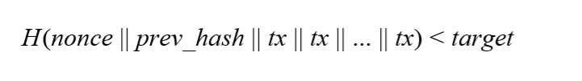
Incentives and proof of work (5)
Bitcoin achieves proof of work using hash puzzles.
This notion of hash puzzles and proof of work completely does away with the requirement to magically pick a random node.
Instead, nodes are simply independently competing to solve these hash puzzles all the time. Once in a while, one of them will get lucky and will find a random nonce that satisfies this property.
That lucky node then gets to propose the next block. That’s how the system is completely decentralized. There is nobody deciding which node it is that gets to propose the next block.
Notes:
In order to create a block, the node that proposes that block is required to find a number or ​nonce, ​such that when you concatenate the nonce, the previous hash, and the list of transactions that comprise that block and take the hash of this whole string, then that hash output should be a number that falls into a target space that is quite small in relation to the much larger output space of that hash function.

Slide 31
Our implementation – A Blockchain Simulator
After we learn all these quite complex theoretical material We chose to build a simulator that will illustrate how blockchain works.

Slide 32
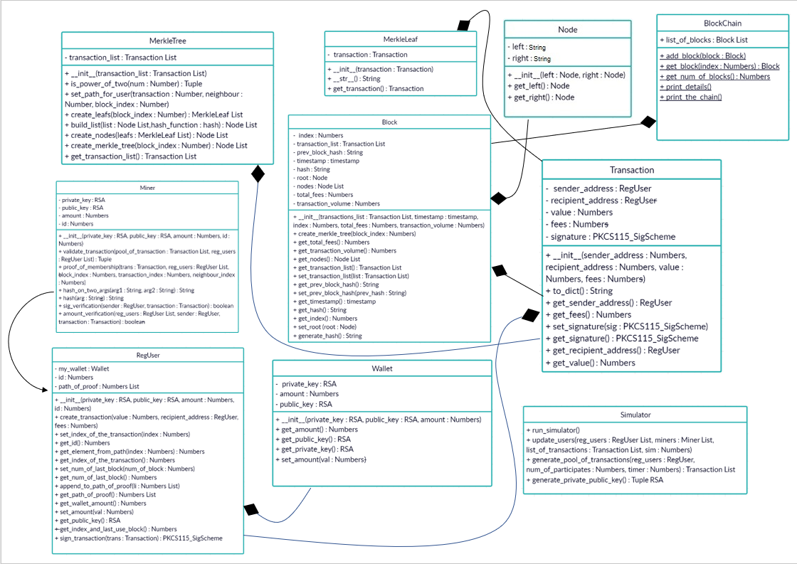
UML – Class Diagram

Slide 33
BlockChain Simulator

Slide 34
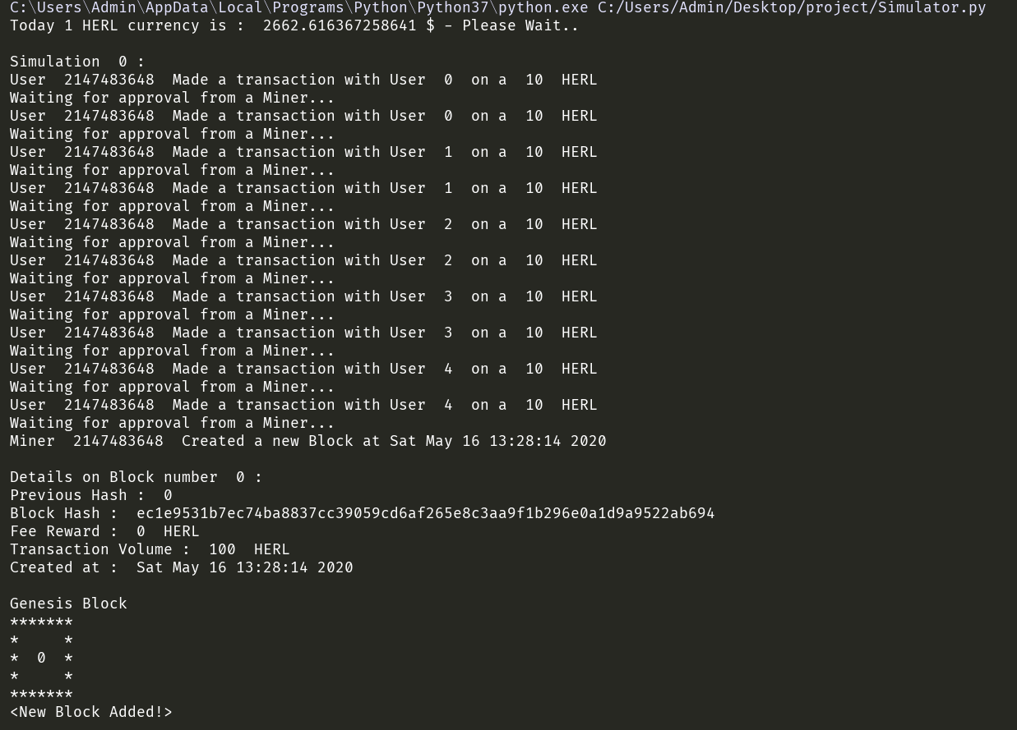
Blockchain Simulator
Our coin (HERL) currency (in dollars)
Simulation 0 – we gave to each user 10 HERL for the currency issuance
We created the first block with timestamp of Sat May 16 13:28:14 2020, called - “the genesis block” (genesis block is the first block of the blockchain. Modern versions of Bitcoin number it as block 0. The genesis block is almost always hardcoded into the software of the applications that utilize its blockchain. It is a special case in that it does not reference a previous block).
https://en.bitcoin.it/wiki/Genesis_block
The details on the block

Slide 35
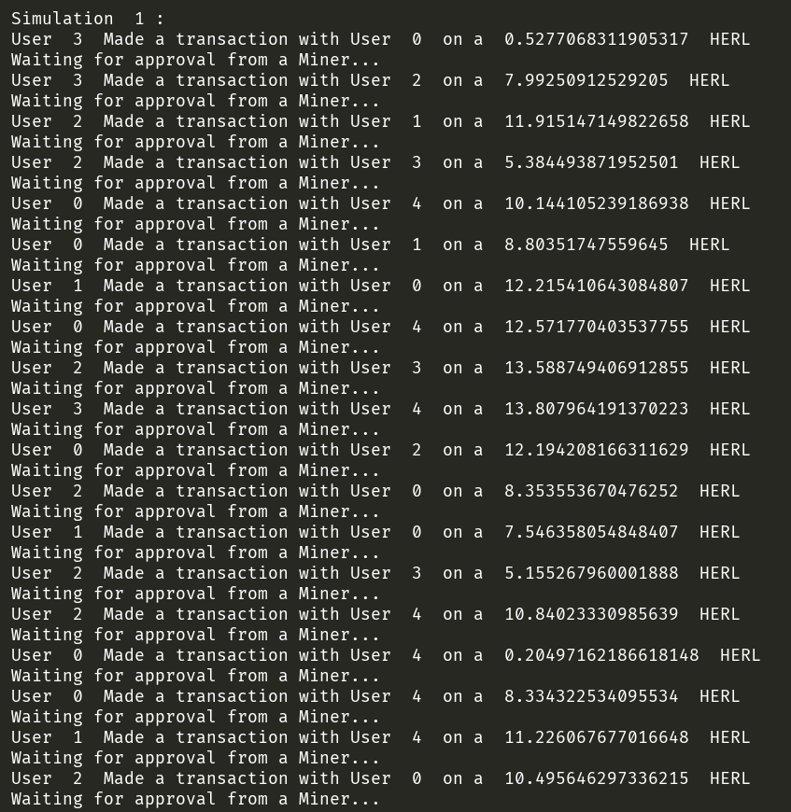
Blockchain Simulator (2)
Simulation 1 – transactions are created from user x to user y with value z. waiting for approval from some miner who will mine the block.

Slide 36
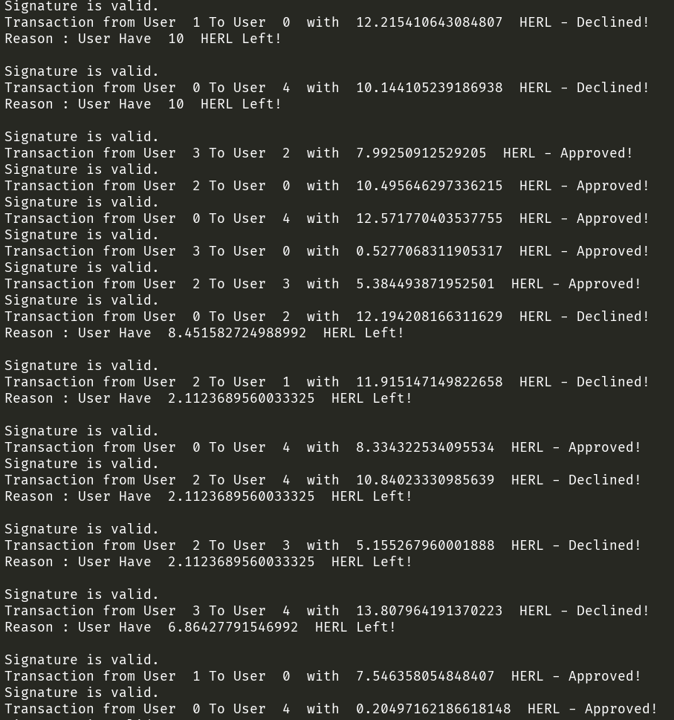
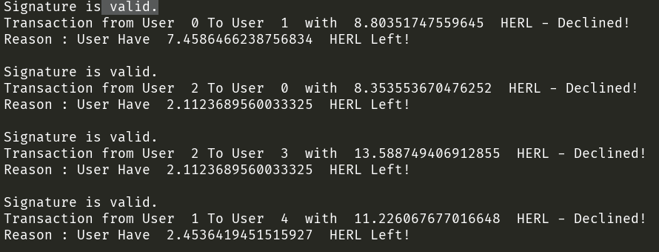
Blockchain Simulator (3)
The miner x check if the transaction t is valid. If this is the case, the miner approves the transaction. otherwise, the transaction is declined.
The miner first checks if the signature is valid by using the public key of the user, that signed on the transaction by the RSA scheme. after that, he checks if the user has enough HERL to create a transaction. He figures it out by looking at the last transaction the user y made (proof of membership).

Slide 37
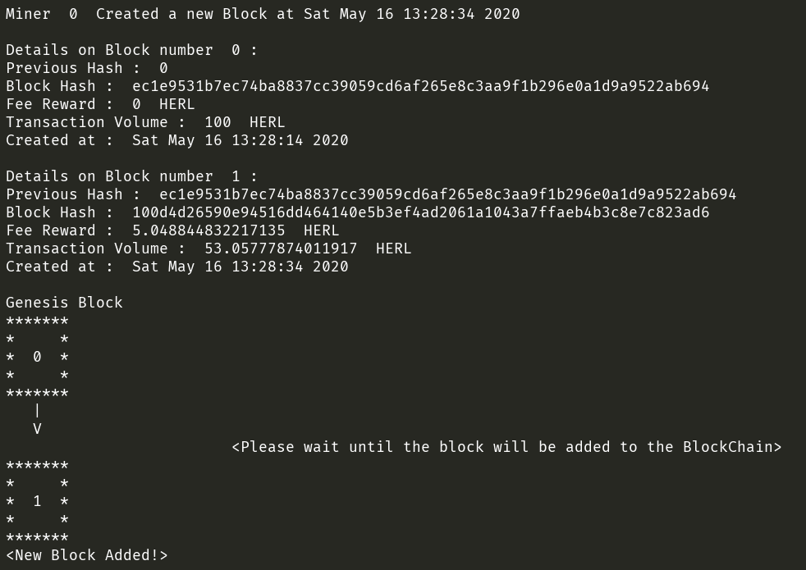
Blockchain Simulator (4)
We can see that the miner 0 created a new block with a timestamp of - Sat May 16 13:28:34 2020.
This is the previous hash of the genesis block.
This is the fee reward for mining the block.
This is the all transactions volume in this block.
Block 1 added to the BlockChain

Slide 38
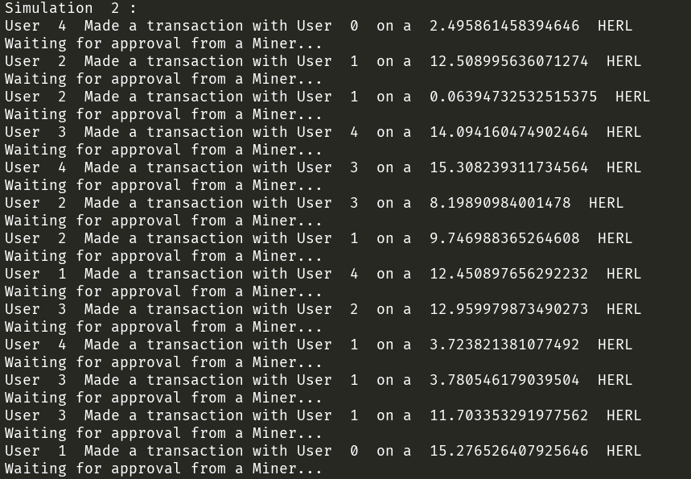
Blockchain Simulator (5)
One more simulation to demonstrate the blockchain simulator.

Slide 39
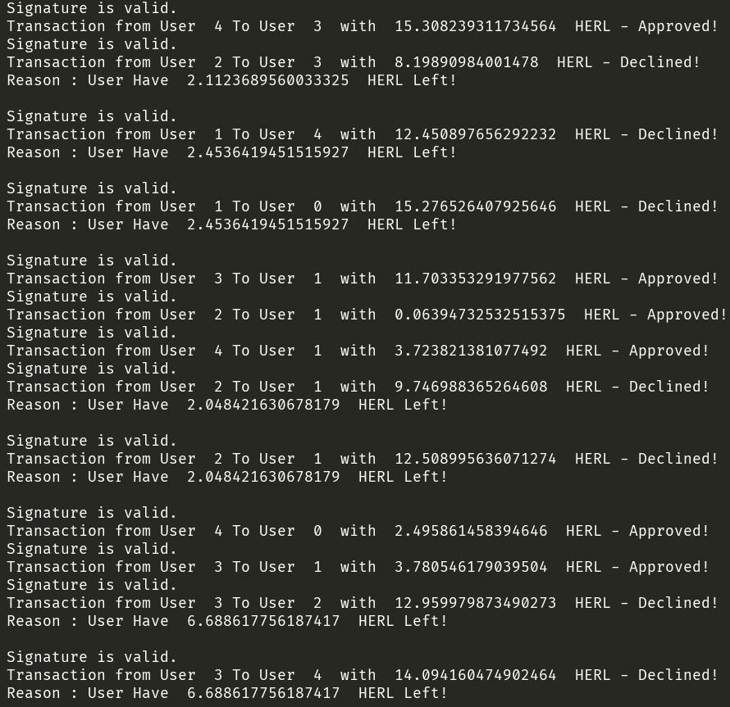
Blockchain Simulator (6)

Slide 40
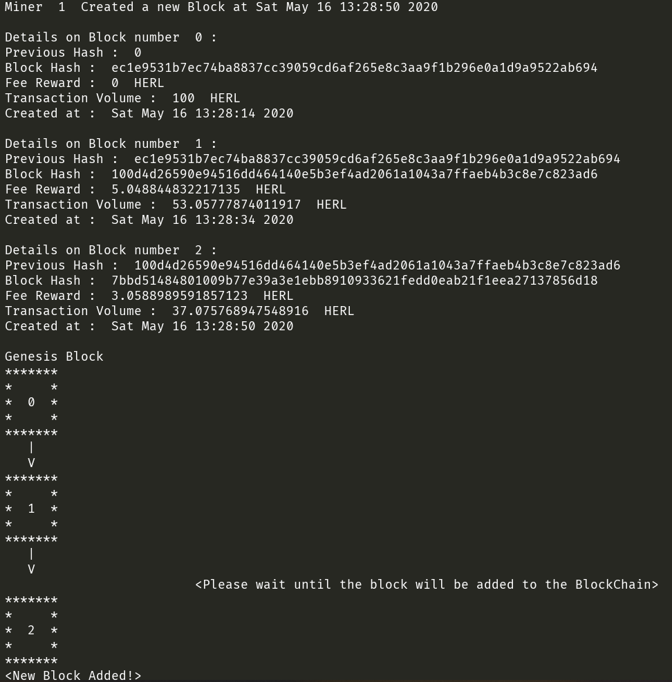
Blockchain Simulator (7)

Slide 41
Summary
So, what have we learned in this project?
at our research part, we got exposed to the crypto world - from the basics of intro to cryptography to complex models of cryptocurrency.
by implementing our simulator:
we learned a new programming language - Python.
We got familiar with crypto libraries: RSA, SHA256, PKCS115_SigScheme (RSA signature scheme).
we understood better the concepts that we learned at the research part - Blockchain and Merkle tree mechanism, proof of membership, encryption and decryption, Miners VS regular users and etc.
We will expand the project at the future for sure, we will add P2P and Decentralization to the blockchain, a web page for demonstrate the mining and the transactions movement.

